Slide 1
AUTOMATIC IDENTIFICATION AND ANALYSIS OF COMMENTED OUT CODE
Author: Blake Grills
Advisor: Michael Decker

Slide 2
Motivation
Commented-out code causes problems in code comprehension.
Commented-out code can cause legal problems.
Aids in improving techniques that rely on comments such as IR techniques.
Inserting code which has been commented out in an active program can cause unpredictable results.

Slide 3
Knight Capital
An updated copy of Knight Capital’s stock purchasing software was deployed on seven of their eight servers with an active piece of previously commented-out code.
This commented-out code led to the purchase of over seven billion dollars’ worth of stock in the span of one hour.
Final loss was 440 million dollars.

Slide 4
What are the Different Ways to Comment?
Type of Comment | Definition
Line Comment | //for(int p = 0;p<P.rows();p++)
Block Comment | /*var cour = EntityManager<Courier>.Entities.FirstOrDefault(); UpdateManager.Subscribe(() => { … }, 1000);*/
#if 0 | #if 0 for(int i = 0; i < 10; ++i){ a += i; } #endif
if(0) | if(0){ for(int i = 0; i < 10; ++i){ a += i; } }
Doxygen | /// Construct an alive Account, with given endowment, for either a normal (non-contract) /// account or for a contract account in the conception phase, where the code is not yet known.
Javadoc | /** * BENCHMARK_START_GROUP(insertVectorBegin, n) { * vector<int> v; … * } */

Slide 5
What is Commented-out Code?
// void Print(int res[20][20], int i, int j, int capacity)
// {
// if(i==0 || j==0)
// {
// return;
// }
// if(res[i-1][j]==res[i][j-1])
// {
// if(i<=capacity)
// {
// cout<<i<<" ";
// }
//}
Any piece of source code that has been disabled by means of one of the previous methods

Slide 6
Process of Manual Classification
Select 78 projects from GitHub
Ran the projects through srcML followed by XPath to retrieve comments.
Select random files from this archive to build the corpus.
Randomly select comments from selected files
Manually review each comment based off the fields of the Gold Set and our Taxonomy.
Secondary sweep of all comments for further verification.

Slide 7
Gold Set
Comment | File | Block Comment | Language | Contains Code | is Code | Standard Terms
//std::cout<<matlab_format(c_candidate,"c_candidate")<<std::endl; | AABB.cpp | n | C++ | y | y | std::cout, std::endl
//// This doesn't quite make sense to check with bounds | AABB.cpp | n | C++ | n | n
// const Scalar pc_norm = (p-c_candidate).squaredNorm(); | AABB.cpp | n | C++ | y | y | const, scalar
// const Scalar diff = fabs(sqr_d_candidate - pc_norm); | AABB.cpp | n | C++ | y | y | const, scalar
// assert(diff<=1e-10 && "distance should match norm of difference"); | AABB.cpp | n | C++ | y | y
// Actually process elements | AABB.cpp | n | C++ | n | n
// Cheesecake way of hitting element | AABB.cpp | n | C++ | n | n
// Since we only gave ray_mesh_intersect a single face, it will have set | AABB.cpp | (512-513) | C++ | n | n
// any hits to id=0. Set these to this primitive's id | AABB.cpp | (512-513) | C++ | n | n

Slide 8
Frequency Calculation
Symbol | Count | Frequency
A | 1 | .048
Space | 4 | .195
= | 1 | .048
S | 1 | .048
Q | 1 | .048
R | 1 | .048
T | 1 | .048
( | 1 | .048
B | 2 | .095
* | 2 | .095
2 | 2 | .095
C | 2 | .095
) | 1 | .048
//a = sqrt(b*b + c*c)
Total Characters = 19
Most Frequent Characters = Space, *,

Slide 9
Frequency Based Approach

Slide 10
Automatic Classification Strategy
Feed 250 (commented-out code) x250 (English Prose) set into a stratified K-fold cross validation K=5.
Utilize the modified CART Decision Tree of sklearn
Review results of the 5 folds to ensure equal value.
Use the 250x250 set as the model standard for analysis.
Do a final verification against the remaining Gold Set to ensure quality of the 250x250 model.

Slide 11
Can We Automatically Detect Commented-Out Code With an Acceptable Margin of Error?
Initial Testing
Fold Number | accuracy | precision | recall | F1
1 | 98.50 | 98.15 | 99.07 | 98.60
2 | 97.00 | 100.00 | 94.00 | 96.91
3 | 97.50 | 95.65 | 98.88 | 97.23
4 | 98.50 | 99.00 | 98.02 | 98.51
5 | 98.00 | 99.01 | 97.09 | 98.04

Slide 12
Can We Automatically Detect Commented-Out Code With an Acceptable Margin of Error? Contd.
Built model using all 250x250 comments
Applied model to the remainder of the Gold Set
Full Set
accuracy | precision | recall | F1
98.00 | 98.32 | 98.23 | 97.89

Slide 13
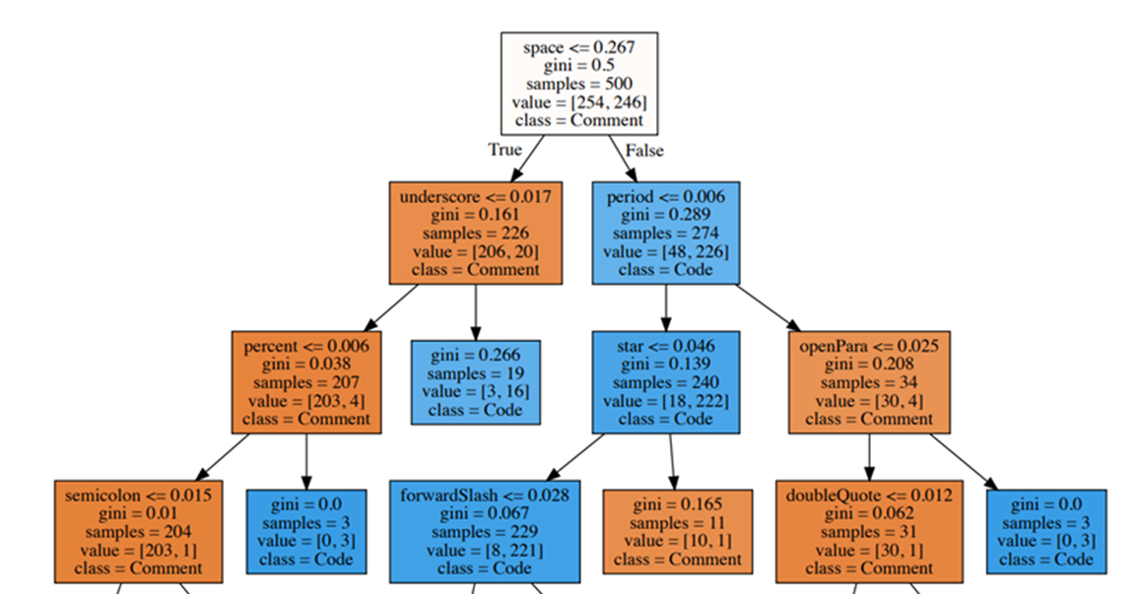
Final Decision Tree Model

Slide 14
How Prevalent is Commented-Out Code in Open-Source Software?
We selected 50 unseen projects not found in the original 78 projects from GitHub following the same collection procedure.
Projects were split C++ - 13 C# - 13 C – 12 Java – 12.
Verified every case of commented out code and 2 nearby pieces of English Prose for each case of commented-out code.
50 Projects Results
accuracy | precision | recall | F1
94.68 | 78.03 | 99.62 | 87.51

Slide 15
How Prevalent is Commented-Out Code in Open-Source Software?
Applied the 250x250 model on 50 projects
50 Projects Additional Data
 | Lines of Comments | Number of Comments | Lines of Commented-out Code | Ratio of comments to Statement LOC | Percentage of Commented-out Code
Total | 2980155 | 1663325 | 176503 | --------- | ---------
Average | 59603.1 | 33266.5 | 3602.102041 | 0.24 | 4.43
Median | 6229 | 3033 | 137 | 0.21 | 2.76

Slide 16
Questions?

